Slide 1
Retention-Aware Container Caching for Serverless Edge Computing
Infocom 2022, HUST, Fangming Liu

Slide 2
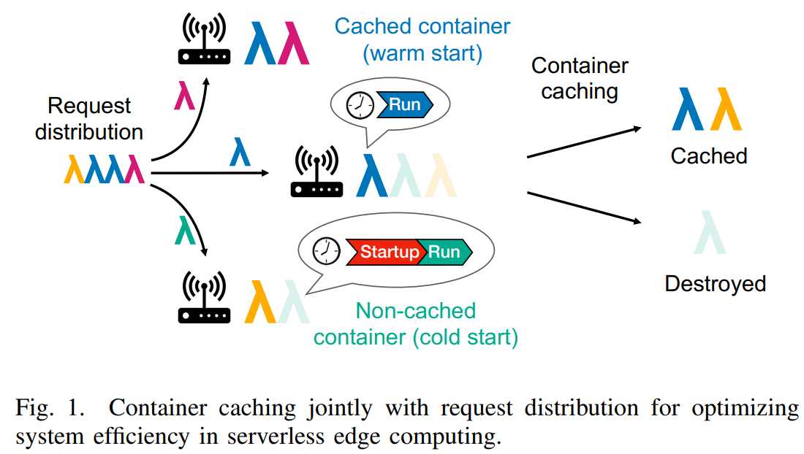
Serverless Edge Computing
An event-based model where Internet-of-Things (IoT) services are executed in lightweight containers only when requested, leading to significantly improved edge resource utilization.
Reusing a cached container for the next triggered call for the same IoT service can reduce the startup latency by at least an order of magnitude. But container caching is not free.
Challenges: 1) Edge nodes are distributed and heterogeneous. 2) Retention-aware container caching decisions have to be made a priori without knowing the future request arrival pattern. 3) Request distribution is hard in nature.

Slide 3
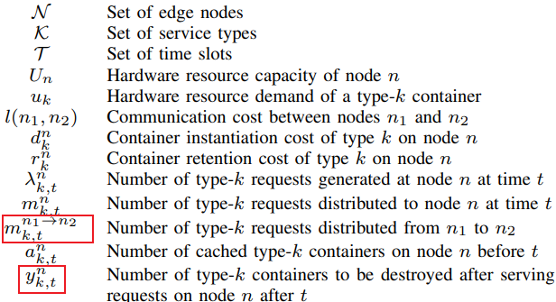
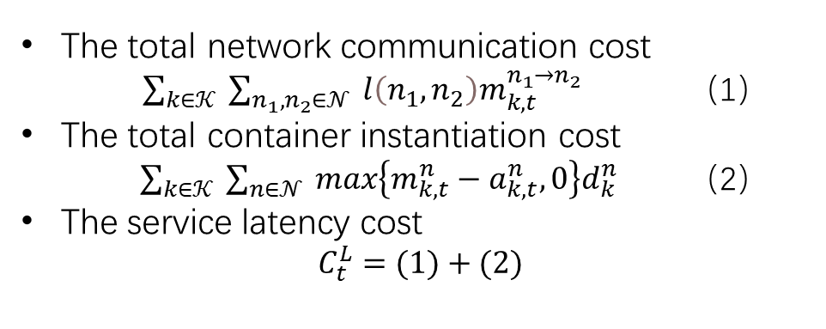
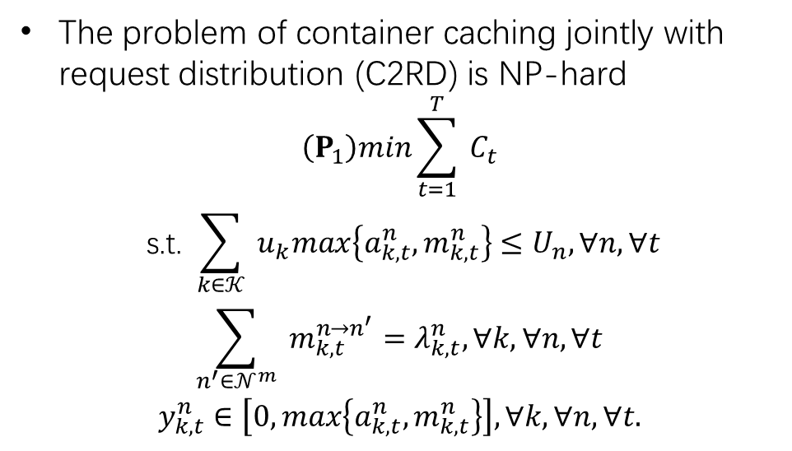
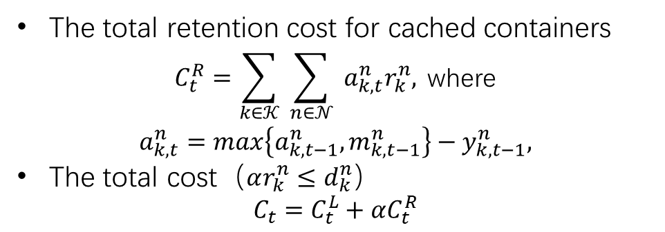
MODEL DESIGN AND PROBLEM FORMULATION
The total retention cost for cached containers
$$\begin{aligned} C_{t}^{R}=\sum_{k∈𝒦}{ }\sum_{n∈𝒩}{ }a_{k,t}^{n}r_{k}^{n}, \text{where} \\ a_{k,t}^{n}=max\left\{a_{k,t−1}^{n},m_{k,t−1}^{n}\right\}−y_{k,t−1}^{n},\end{aligned}$$
The total cost（$αr_{k}^{n}≤d_{k}^{n}$）
$$C_{t}=C_{t}^{L}+αC_{t}^{R}$$
The total network communication cost
$\sum_{k∈𝒦}{ }\sum_{n_{1},n_{2}∈𝒩}{ }l\left(n_{1},n_{2}\right)m_{k,t}^{n_{1}→n_{2}}$ （1）
The total container instantiation cost $\sum_{k∈𝒦}{ }\sum_{n∈𝒩}{ }max\left\{m_{k,t}^{n}−a_{k,t}^{n},0\right\}d_{k}^{n}$ （2）
The service latency cost
$$C_{t}^{L}=(1)+(2)$$
The problem of container caching jointly with request distribution (C2RD) is NP-hard
$$\begin{aligned}\left(P_{1}\right)min\sum_{t=1}^{T}{ }C_{t} \\ \text{s}\text{.}\text{t}\text{. }\sum_{k∈𝒦}{ }u_{k}max\left\{a_{k,t}^{n},m_{k,t}^{n}\right\}≤U_{n},∀n,∀t \\ \sum_{n^{′}∈𝒩^{m}}{ }m_{k,t}^{n→n^{′}}=λ_{k,t}^{n},∀k,∀n,∀t \\ y_{k,t}^{n}∈\left[0,max\left\{a_{k,t}^{n},m_{k,t}^{n}\right\}\right],∀k,∀n,∀t.\end{aligned}$$
Notes:
The first constraint ensures that the hardware resource limit is respected on every node. The second constraint states that every request will be distributed to exactly one node.

Slide 4
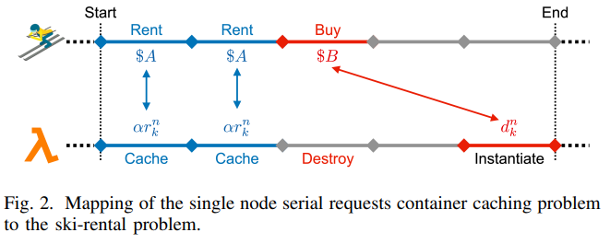
ALGORITHMS FOR SPECIAL CASES
Hardware resource constraint is relaxed and Network latency is omitted (In the same zone)
We consider one node receiving serial requests in the system. In a single time slot, there is at most one request of the same type arriving. This problem can be mapped to the classic ski-rental problem.
Information about request arrivals cannot be known a priori in most online scenarios. There are two classes of online algorithms for the ski-rental problem: deterministic and probabilistic
For single node concurrent requests, we assign decreasing priorities to the containers of the same type where requests served by available containers with higher priorities. In a time slot, the i-th request will be served by the container with the i-th highest priority and the decisions for container caching will be separated from each other. The results presented above will apply directly.
Notes:
If we knew that there would be another request arriving before or in time slot $t+d_{k}^{n}/αr_{k}^{n}$, the optimal decision would be to cache the container; otherwise, the decision is to destroy the container.

Slide 5
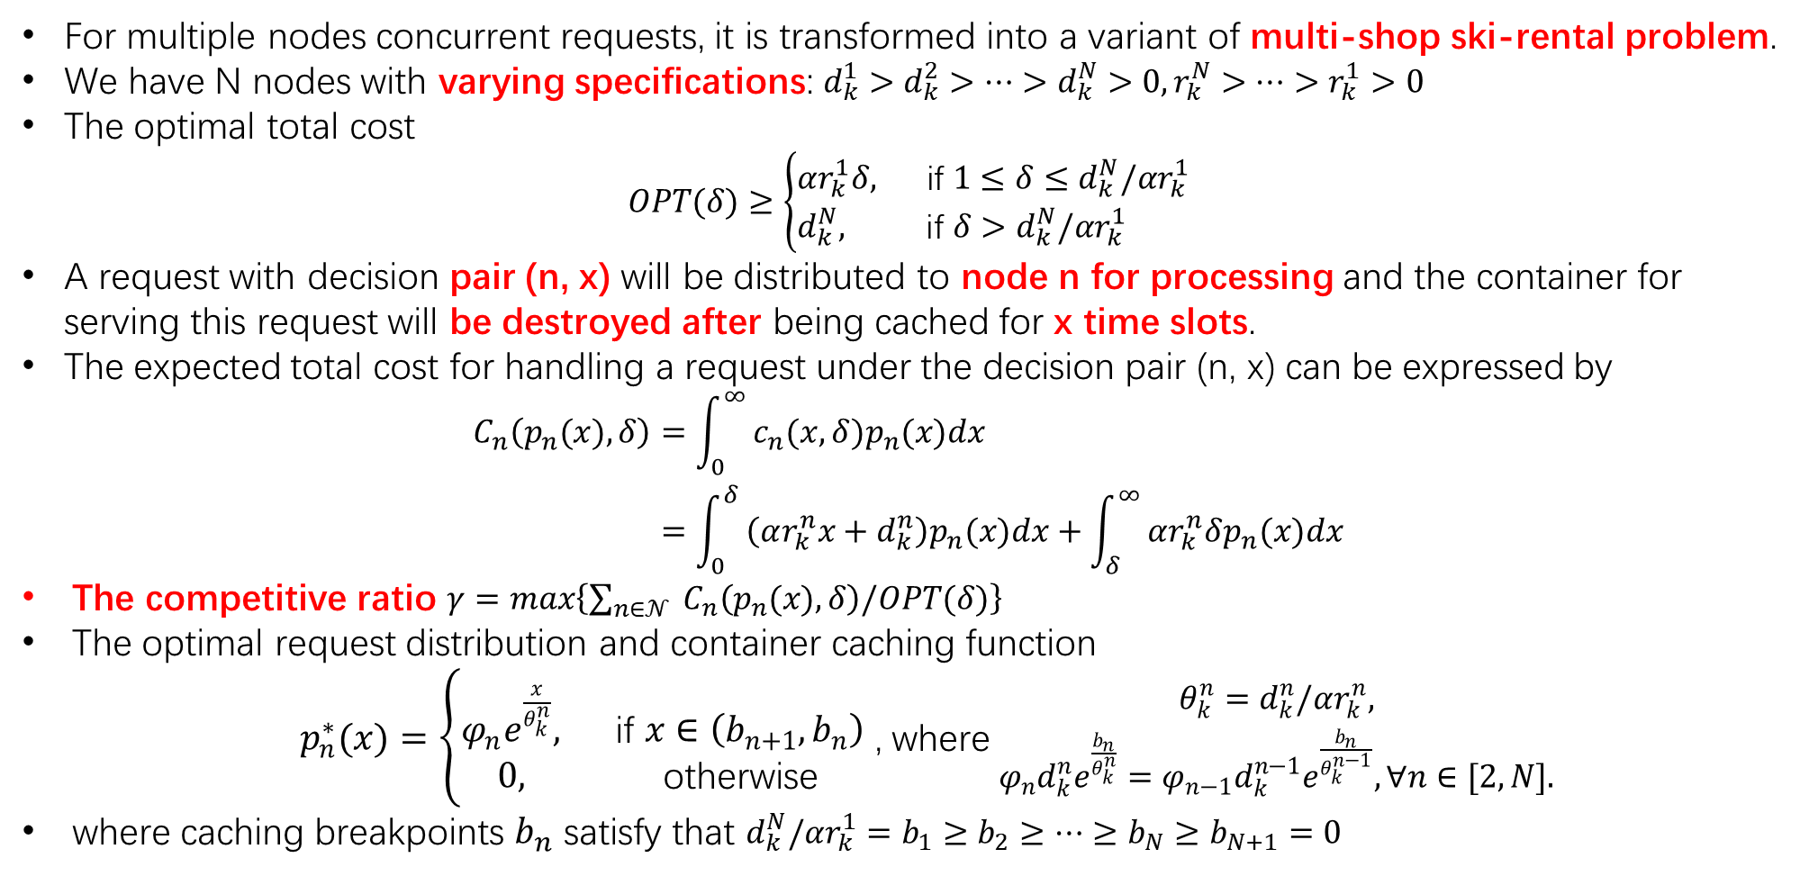
ALGORITHMS FOR SPECIAL CASES
For multiple nodes concurrent requests, it is transformed into a variant of multi-shop ski-rental problem.
We have N nodes with varying specifications: $d_{k}^{1}>d_{k}^{2}>…>d_{k}^{N}>0,r_{k}^{N}>…>r_{k}^{1}>0$
The optimal total cost
$$OPT(δ)≥\left\{\begin{aligned}&αr_{k}^{1}δ, && \text{if} 1≤δ≤d_{k}^{N}/αr_{k}^{1} \\ &d_{k}^{N}, && \text{if} δ>d_{k}^{N}/αr_{k}^{1}\end{aligned}\right.$$
A request with decision pair (n, x) will be distributed to node n for processing and the container for serving this request will be destroyed after being cached for x time slots.
The expected total cost for handling a request under the decision pair (n, x) can be expressed by
$$\begin{aligned}C_{n}\left(p_{n}(x),δ\right)&=\int_{0}^{∞}{ }c_{n}(x,δ)p_{n}(x)dx \\ &=\int_{0}^{δ}{ }\left(αr_{k}^{n}x+d_{k}^{n}\right)p_{n}(x)dx+\int_{δ}^{∞}{ }αr_{k}^{n}δp_{n}(x)dx\end{aligned}$$
The competitive ratio $γ=max\left\{\sum_{n∈𝒩}{ }C_{n}\left(p_{n}(x),δ\right)/OPT(δ)\right\}$
The optimal request distribution and container caching function
$p_{n}^{∗}(x)=\left\{\begin{aligned}φ_{n}e^{\frac{x}{θ_{k}^{n}}}, \text{if} x∈\left(b_{n+1},b_{n}\right) \\ 0, \text{otherwise} \end{aligned}\right.$ , where $\begin{aligned}θ_{k}^{n}=d_{k}^{n}/αr_{k}^{n}, \\ φ_{n}d_{k}^{n}e^{\frac{b_{n}}{θ_{k}^{n}}}=φ_{n−1}d_{k}^{n−1}e^{\frac{b_{n}}{θ_{k}^{n−1}}},∀n∈[2,N].\end{aligned}$
where caching breakpoints $b_{n}$ satisfy that $d_{k}^{N}/αr_{k}^{1}=b_{1}≥b_{2}≥…≥b_{N}≥b_{N+1}=0$
Notes:
· d^n_k Container instantiation cost, r^n_k Container retention cost。更高的规范将提供更低的容器实例化成本，但容器保留成本将更大。
· If we knew that there would be another request arriving before or in time slot $t+d_{k}^{n}/αr_{k}^{n}$, the optimal decision would be to cache the container; otherwise, the decision is to destroy the container.

Slide 6
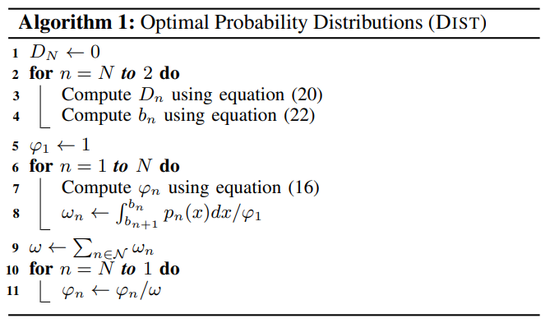
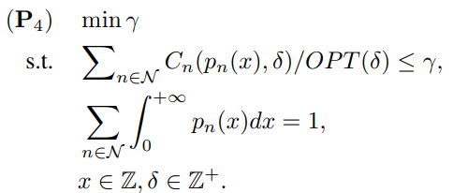
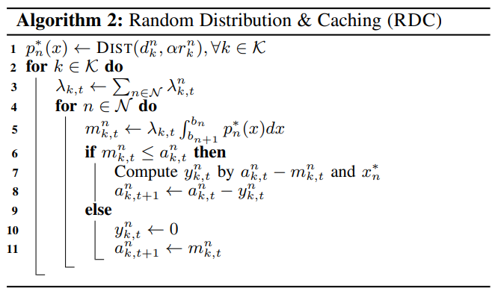
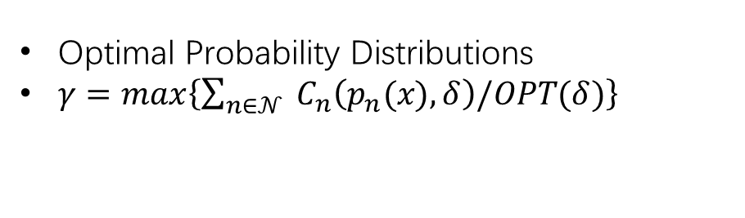
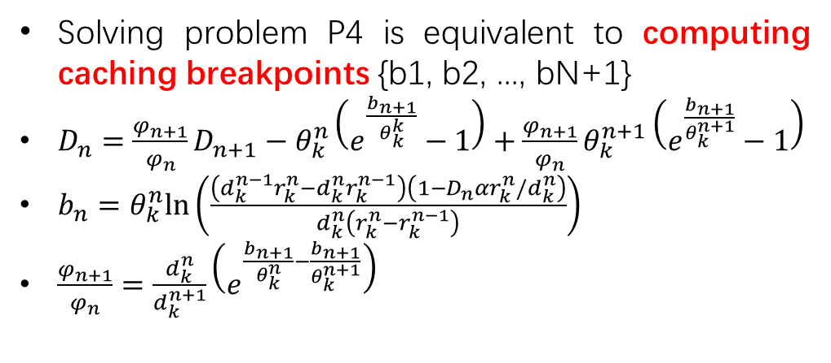
ALGORITHMS FOR SPECIAL CASES
Optimal Probability Distributions
$γ=max\left\{\sum_{n∈𝒩}{ }C_{n}\left(p_{n}(x),δ\right)/OPT(δ)\right\}$
Solving problem P4 is equivalent to computing caching breakpoints {b1, b2, ..., bN+1}
$D_{n}=\frac{φ_{n+1}}{φ_{n}}D_{n+1}−θ_{k}^{n}\left(e^{\frac{b_{n+1}}{θ_{k}^{k}}}−1\right)+\frac{φ_{n+1}}{φ_{n}}θ_{k}^{n+1}\left(e^{\frac{b_{n+1}}{θ_{k}^{n+1}}}−1\right)$
$b_{n}=θ_{k}^{n}ln⁡\left(\frac{\left(d_{k}^{n−1}r_{k}^{n}−d_{k}^{n}r_{k}^{n−1}\right)\left(1−D_{n}αr_{k}^{n}/d_{k}^{n}\right)}{d_{k}^{n}\left(r_{k}^{n}−r_{k}^{n−1}\right)}\right)$
$\frac{φ_{n+1}}{φ_{n}}=\frac{d_{k}^{n}}{d_{k}^{n+1}}\left(e^{\frac{b_{n+1}}{θ_{k}^{n}}−\frac{b_{n+1}}{θ_{k}^{n+1}}}\right)$
The multi-shop ski rental problem, SIGMETRICS, 2014
Notes:
根据$\int_{b_{n}+1}^{b_{n}}{ }p_{n}^{∗}(x)dx$概率向每个节点发送请求。一旦收到请求，我们就决定销毁哪些容器。如果缓存的容器数大于此时间段中生成的请求数，我们将销毁缓存时间超过xn自上次服务请求以来的时隙。该算法是我们在下一节中描述的在线算法的基本组成部分。
$\lambda_{k, t}^n \quad$ Number of type- $k$ requests generated at node $n$ at time $t$
$m_{k, t}^n \quad$ Number of type- $k$ requests distributed to node $n$ at time $t$

Slide 7
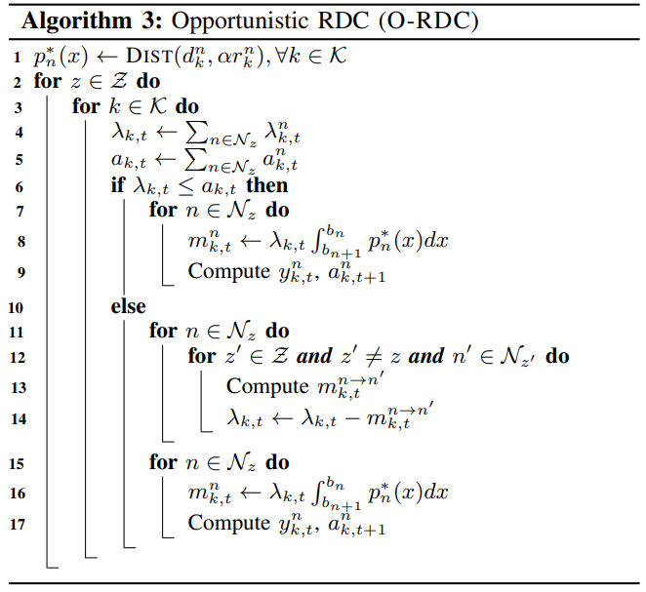
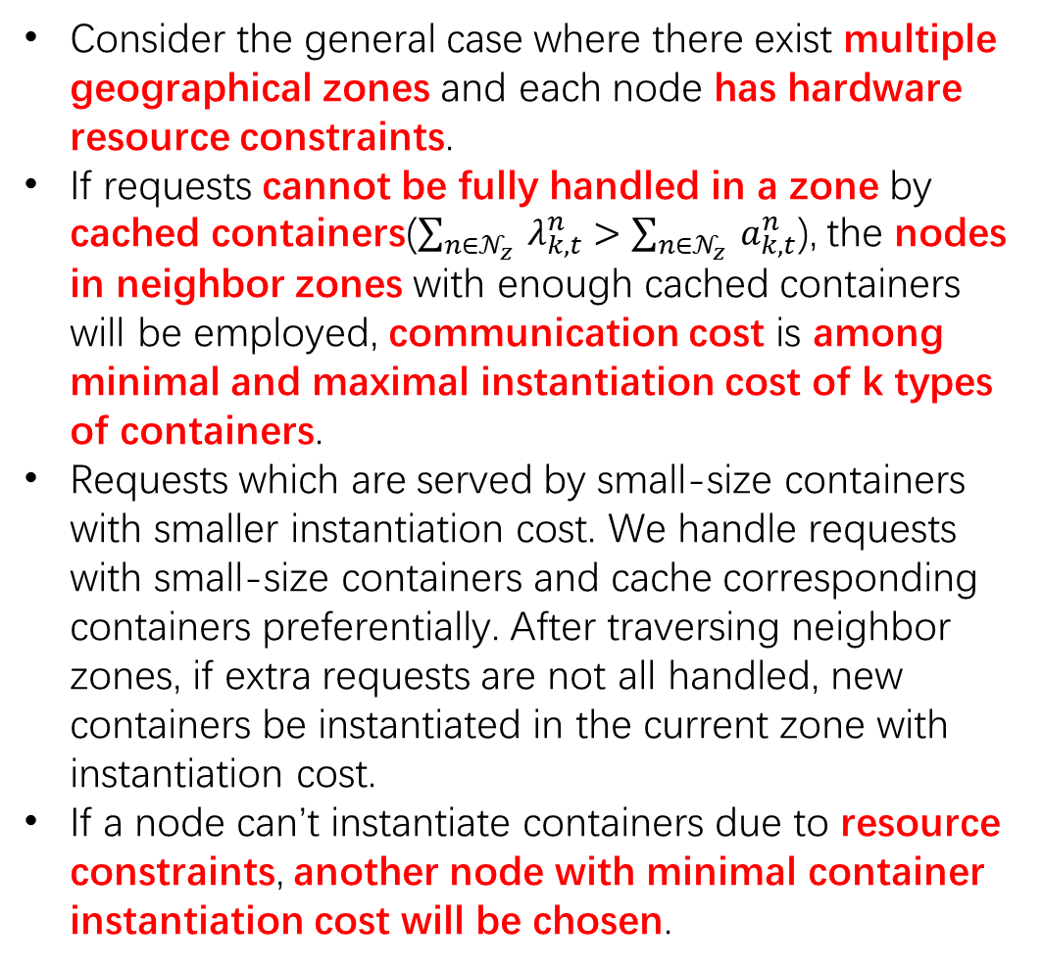
CONTAINER CACHING FOR THE GENERAL CASE
Consider the general case where there exist multiple geographical zones and each node has hardware resource constraints.
If requests cannot be fully handled in a zone by cached containers($\sum_{n∈𝒩_{z}}{ }λ_{k,t}^{n}>\sum_{n∈𝒩_{z}}{ }a_{k,t}^{n}$), the nodes in neighbor zones with enough cached containers will be employed, communication cost is among minimal and maximal instantiation cost of k types of containers.
Requests which are served by small-size containers with smaller instantiation cost. We handle requests with small-size containers and cache corresponding containers preferentially. After traversing neighbor zones, if extra requests are not all handled, new containers be instantiated in the current zone with instantiation cost.
If a node can’t instantiate containers due to resource constraints, another node with minimal container instantiation cost will be chosen.

